Slide 1
The battle of neighbourhoods
Finding an ideal location of opening a healthy food and supplements store in London

Slide 2
Introduction
Object: to define some ideal locations for opening a healthy food and supplements store in London, based on venues data of each neighborhood , for a well-known Asian firm
Target location: obviously, near gyms and fitness centers, as this portion of people visiting these places is more prone to buy company’s providing products

Slide 3
Data
Data from wikipedia to get London’s neighborhoods
Data from Google Maps geocoding API to get the exact location(latitude and longitude) of each neighborhood
Data from Foursquare to get nearest venues of each neighborhood

Slide 4
Methodology
Collecting all appropriate data and pre-processing
Find 10 most common venues for each neighborhood
Cluster neighborhoods using K-Means algorithm , having found first optimal K
Examine the algorithm’s results and suggest solutions

Slide 5
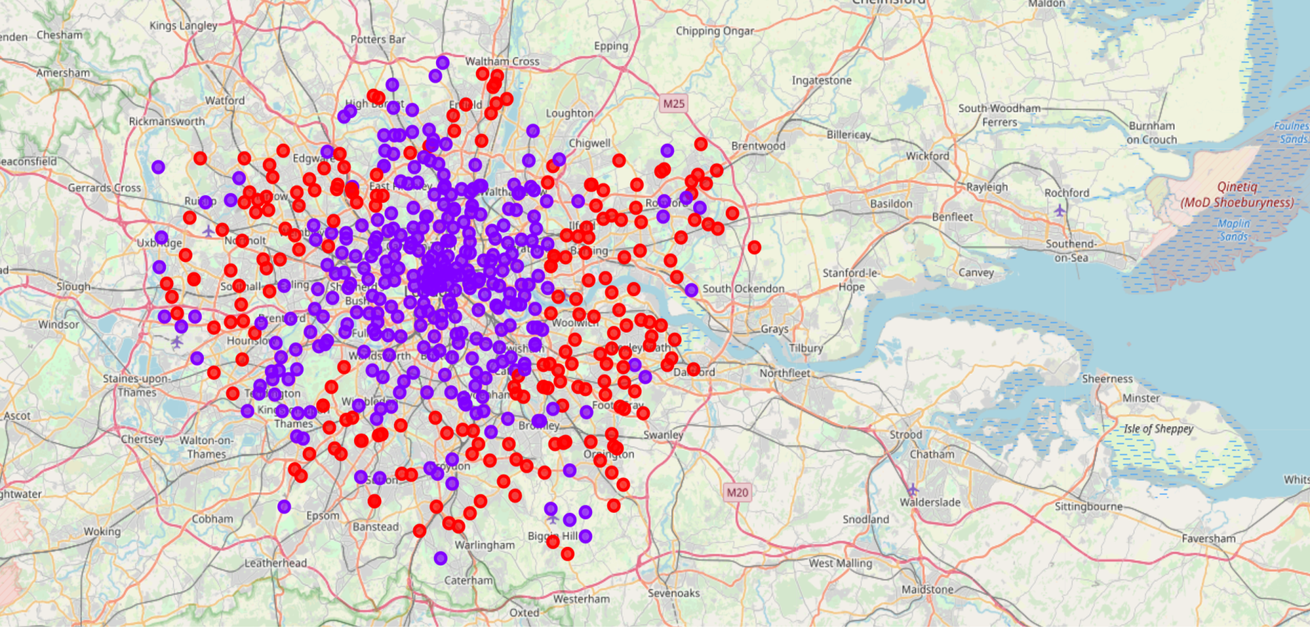
Results(1)
2 clusters, containing similar venues

Slide 6
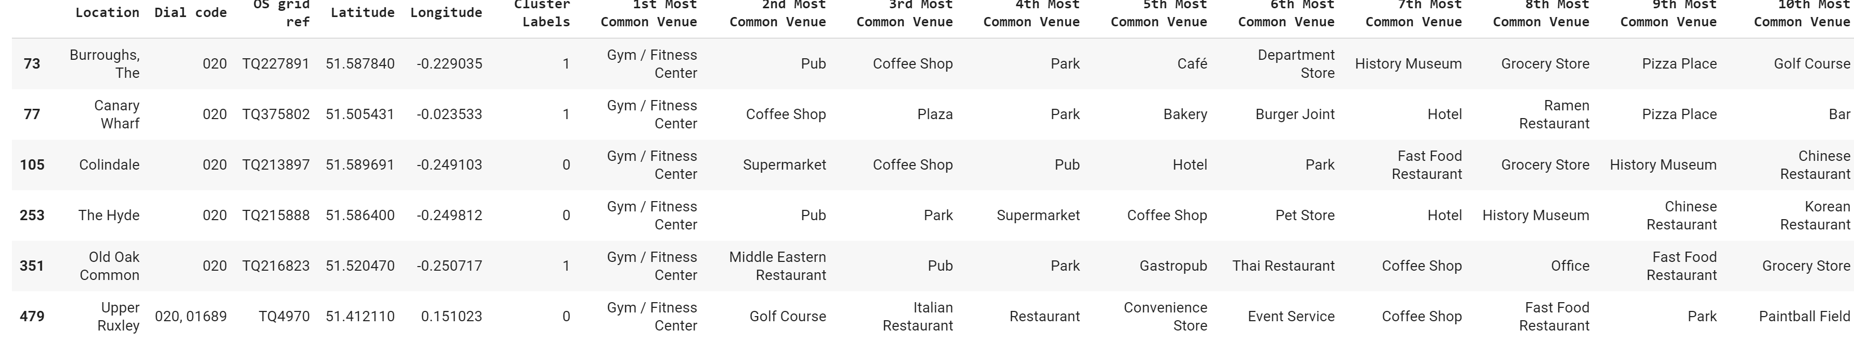
Results(2)
6 different ideal locations, 3 on each cluster, having as 1st common venue Gym / Fitness Center

Slide 7
Discussions
2 clusters, based on venues in London => all venues are located similarly on each neighborhood => London a modern city
By adding more data(-constraints) like neighborhood’s crime rates(-safety), average income(quality of target group) and housing prices(-rental prices),etc we can build a more accurate model
Generally speaking, the more DATA we have is POWER the more accurate our model IS

Slide 8
Conclusion
Goal: find some ideal locations, based on neighborhood’s venues occurancy
Data: collect, combine and process data from wikipedia, Google Maps geocoding API and Foursquare
Use of K-Means algorithm to segment neighborhoods by most common venues and find where target places are
Remember: Data is POWER. By collecting, combing and analyzing data, we can build great models, achieving great results!

Slide 9
Thank you

